Slide 1


INSTITUTE: CHANDIGARH UNIVERSITY
DEPARTMENT: UIC
MCA
SOFTWARE TESTING
24CAH-654
DISCOVER . LEARN . EMPOWER

Slide 2

SOFTWARE TESTING
Unit -3
Test Management using JIRA

Slide 3
Introduction To JIRA
JIRA is a popular project management and issue tracking tool developed by Atlassian. It is widely used for software development, bug tracking, issue tracking, and project management across various industries. JIRA is highly customizable, providing teams with a flexible and collaborative platform to plan, track, and manage their work.
Key Features of JIRA:
Issue Tracking:
JIRA allows users to create, track, and manage issues or tasks. Issues can represent anything from bugs and new features to user stories and tasks.
Customizable Workflows:
JIRA supports customizable workflows that reflect the specific processes and stages of your projects. Workflows define how issues move through different states.

Slide 4
3. Agile Project Management:
JIRA Agile, now known as JIRA Software, is an Agile project management tool integrated into JIRA. It supports Agile methodologies like Scrum and Kanban, allowing teams to plan, track, and release software iteratively.
4. Integration with Development Tools:
JIRA integrates seamlessly with various development tools, including version control systems (e.g., Git, SVN) and continuous integration servers (e.g., Jenkins), ensuring a smooth flow of information between development and project management.
5. Custom Fields and Issue Types:
Users can define custom fields to capture specific information for different types of issues. JIRA supports a variety of issue types, such as task, bug, story, epic, etc.
6. Reporting and Dashboards:
JIRA provides powerful reporting features with a variety of built-in reports. Users can create customized dashboards to track progress, monitor team performance, and visualize project metrics.

Slide 5
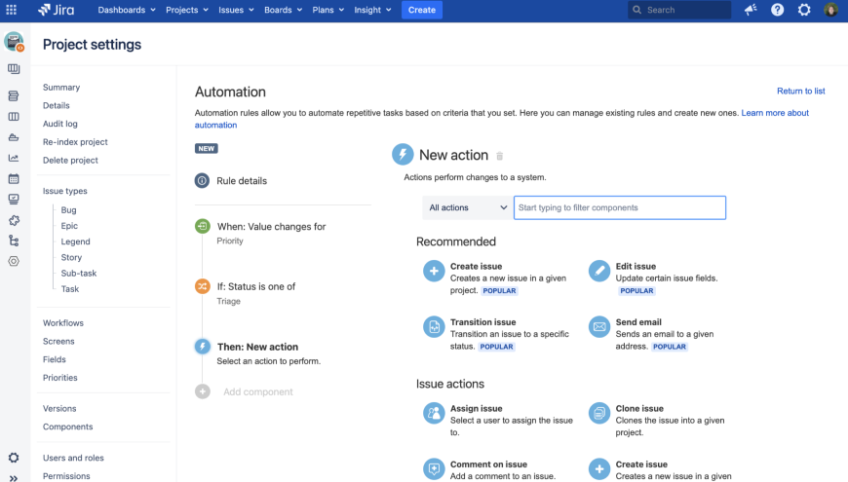

Slide 6
Test Management In JIRA
Test management in JIRA is facilitated by the use of JIRA's native functionalities and plugins specifically designed for test management. Below are some key aspects of test management in JIRA:
Test Management Components in JIRA:
Test Issues:
In JIRA, test cases are represented as issues. You can create a dedicated issue type for test cases, and each test case is managed as a JIRA issue with its unique ID, summary, description, and other attributes.
Test Execution:
Test execution refers to the process of executing test cases. JIRA Software includes a feature called "Test Execution" that allows you to plan and execute test cases within JIRA. You can create test cycles, assign test cases to them, and track their execution status.
Test Cycles and Test Plans:
Test cycles and test plans are concepts used in JIRA for organizing and managing test executions. A test plan can include multiple test cycles, each representing a set of test cases to be executed in a particular phase or iteration.

Slide 7
4. Traceability:
JIRA provides traceability by linking test cases to the corresponding requirements or user stories. This allows teams to establish a clear connection between test coverage and project requirements.
5.Integration with Automation Tools:
JIRA can be integrated with various test automation tools. Automated test results can be linked to JIRA issues, providing a consolidated view of both manual and automated test execution.
6. Defect Tracking:
When defects are identified during testing, they can be logged as issues in JIRA. The integration of test cases, test execution, and defect tracking provides end-to-end visibility into the testing process.
7. Reporting and Dashboards:
JIRA offers built-in reports and dashboards for test management. These include reports on test execution progress, defect trends, and overall testing coverage.

Slide 8
Advanced Search and Introduction to JQL (JIRA Query Language)
In JIRA, Advanced Search allows users to perform complex and customized queries to filter and retrieve specific sets of issues based on various criteria. Behind the scenes, JIRA uses a query language called JQL (JIRA Query Language) for constructing these queries. JQL is a powerful and flexible language that enables users to build sophisticated search queries.
Advanced Search in JIRA:
Accessing Advanced Search:
In JIRA, the Advanced Search can be accessed by clicking on the "Issues" menu and selecting "Search for issues." You can then switch to the "Advanced" tab to use JQL for building your queries.

Slide 9
Basic Usage:
Advanced Search allows users to construct queries using a combination of keywords, field names, operators, and values. For example, you can search for all open issues assigned to a specific user with a query like assignee = username AND status = Open.
Field Suggestions:
As you type in JQL, JIRA provides suggestions for field names and values to assist in constructing valid queries.
Operators:
JQL supports various operators, including equality (=), inequality (!=), comparison (<, >, <=, >=), logical operators (AND, OR, NOT), and more.
Functions:
JQL includes functions that can be used to perform calculations or extract information. For example, the count() function can be used to count the number of issues matching certain criteria.

Slide 10
THANK YOU

